Slide 1

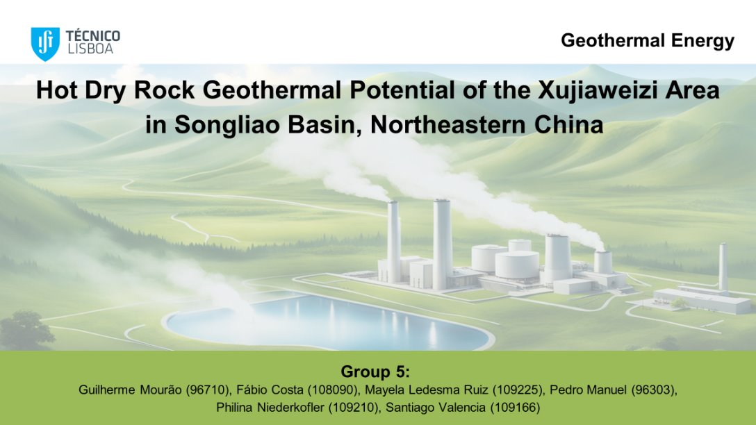
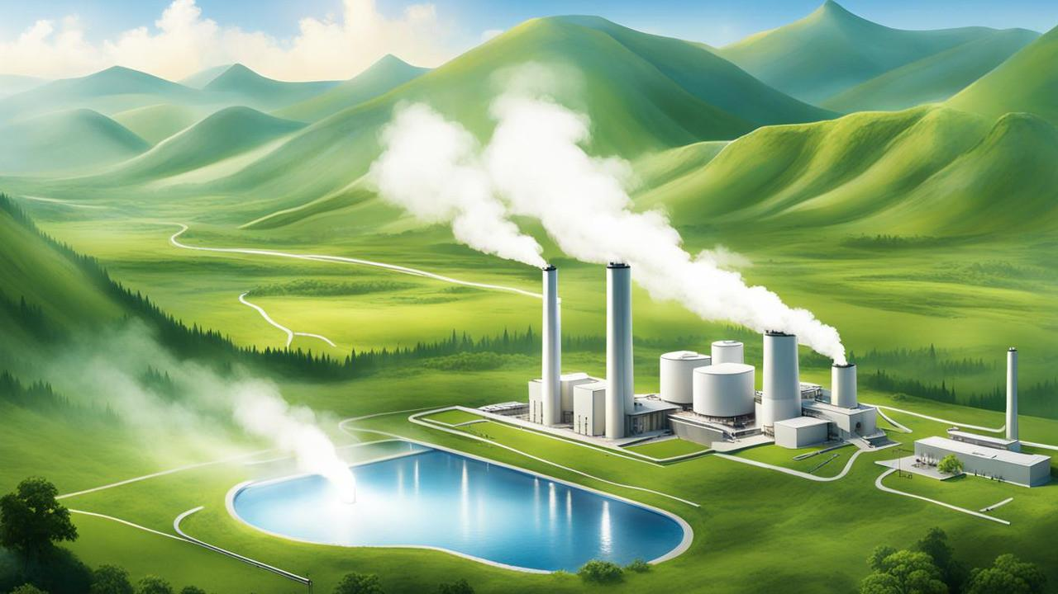
Geothermal Energy
Hot Dry Rock Geothermal Potential of the Xujiaweizi Area in Songliao Basin, Northeastern China
Group 5:
Guilherme Mourão (96710)
Fábio Costa (108090)
Mayela Ledesma Ruiz (109225)
Pedro Manuel (96303)
Philina Niederkofler (109210)
Santiago Valencia (109166)

Slide 2
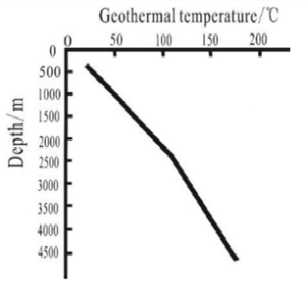
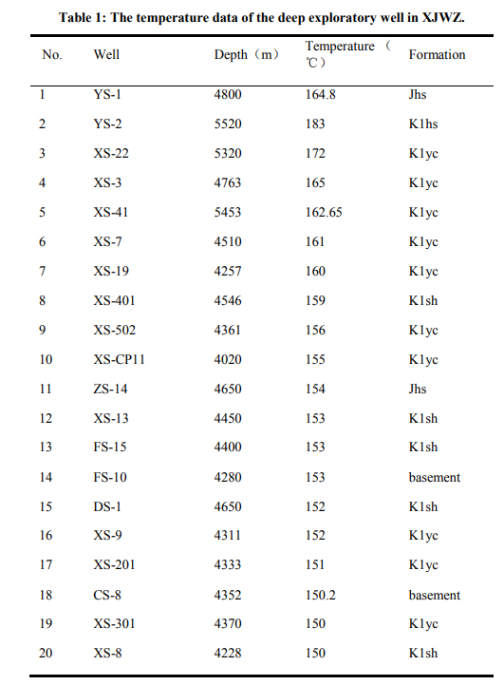
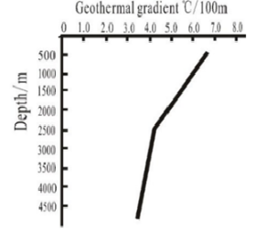
Geothermal Field
Geothermal Temperature and Gradient
Data from oil and gas exploratory wells in Daqing Oilfield;
“Linear” correlation between temperature and depth;
Turning point in the fault-depression transition;
Gradient :
Fig 1: Variation of geothermal temperature and gradient with depth
- Guo, L., Zhang, Y., Yu, Z. et al. Hot dry rock geothermal potential of the Xujiaweizi area in Songliao Basin, northeastern China. Environ Earth Sci 75, 470 (2016).
- https://www.iea.org/data-and-statistics/charts/geothermal-power-generation-in-the-sustainable-development-scenario-2000-2030

Slide 3
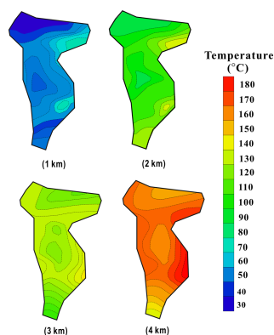
Geothermal Field
Geothermal Temperature and Gradient
Temperature distribution at different depths
Depth [m] | Temperature Range [ºC ] | Average Temperature [ºC]
1000 | 39 - 60 | 48
2000 | 75 - 140 | 96
3000 | 108 - 136 | 121
4000 | 144 - 180 | 162
- Guo, L., Zhang, Y., Yu, Z. et al. Hot dry rock geothermal potential of the Xujiaweizi area in Songliao Basin, northeastern China. Environ Earth Sci 75, 470 (2016).
- https://www.iea.org/data-and-statistics/charts/geothermal-power-generation-in-the-sustainable-development-scenario-2000-2030

Slide 4
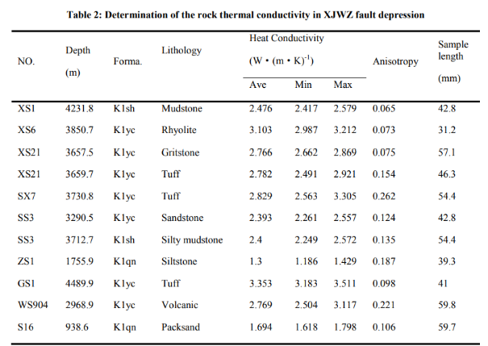
Geothermal Field
Rock thermal properties
- Guo, L., Zhang, Y., Yu, Z. et al. Hot dry rock geothermal potential of the Xujiaweizi area in Songliao Basin, northeastern China. Environ Earth Sci 75, 470 (2016).
- https://www.iea.org/data-and-statistics/charts/geothermal-power-generation-in-the-sustainable-development-scenario-2000-2030

Slide 5
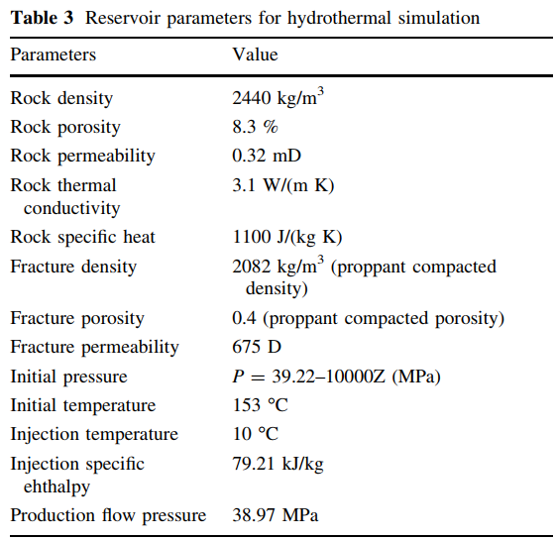
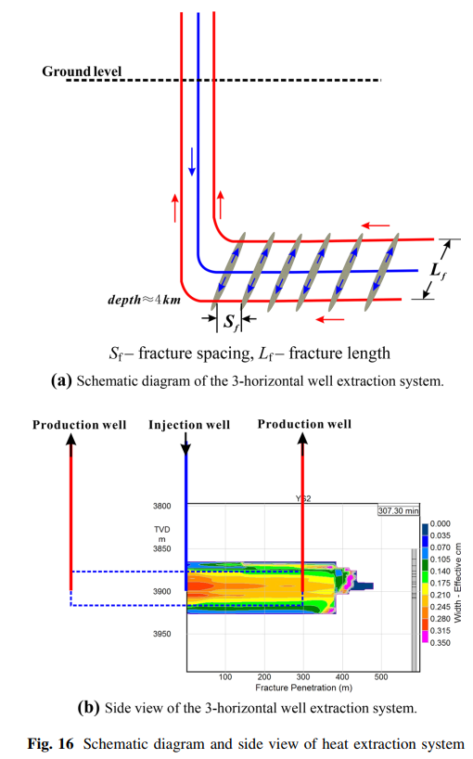
Concept of Enhanced Geothermal System
Schematic diagram and side view of heat extraction well

Slide 6
Concept of Enhanced Geothermal System

Slide 7
References
Zhang, Y. J., Li, Z. W., Guo, L. L., Gao, P., Jin, X. P., & Xu, T. F. (2014, December). Electricity generation from enhanced geothermal systems by oilfield produced water circulating through reservoir stimulated by staged fracturing technology for horizontal wells: A case study in Xujiaweizi area in Daqing Oilfield, China. Energy, 78, 788–805. https://doi.org/10.1016/j.energy.2014.10.073
Guo, L., Zhang, Y., Yu, Z., Hu, Z., Lan, C., & Xu, T. (2016, March). Hot dry rock geothermal potential of the Xujiaweizi area in Songliao Basin, northeastern China. Environmental Earth Sciences, 75(6). https://doi.org/10.1007/s12665-016-5327-9

Slide 8
Thank you for
your attention!

